Slide 1


NEXT GEN EMPLOYABILITY PROGRAM
CREATING A FUTURE-READY WORKFORCE
Student Name :
AMAL P K
Student ID :
College Name :
STU612b328d2a1d61630220941
COLLEGE OF ENGINEERING, THALASSERY

Slide 2
CAPSTONE PROJECT SHOWCASE
Project Title
FINANCE TRACKER
Abstract | Problem Statement | Project Overview | Proposed Solution | Technology Used | Modelling & Results | Conclusion | Q&A

Slide 3
Abstract
1
The Finance Tracker project is a web-based application designed to help users manage their income, expenses, and savings efficiently
2
The system integrates a React-based frontend with a Node.js and Express backend, storing data in a MongoDB atlas database
3
It provides a user-friendly interface for tracking transactions, categorizing expenses, and analyzing financial trends.
4
The goal of this project is to offer users a simple yet powerful tool for financial planning and decision-making

Slide 4


Problem Statement
Many people struggle to manage their finances, leading to overspending and lack of savings.
Existing finance tools are often complex, expensive, or lack customization.
Our solution provides a simple, user-friendly finance tracking tool.
We focus on simplicity and include only essential features, avoiding unnecessary complexity.

Slide 5

Project Overview
The Finance Tracker application allows users to:
Add, edit, and delete income and expense transactions.
Categorize transactions for better analysis.
View financial summaries and analytics.
Securely store financial data using MongoDB.
The application follows the MERN (MongoDB Atlas, Express, React, Node.js) stack for seamless interaction between the frontend and backend.

Slide 6
Proposed Solution
To overcome financial tracking difficulties, the proposed solution is a full-stack web application that provides:
A modern, responsive UI developed with React and Bootstrap.
A robust backend using Node.js and Express for managing transactions.
API communication using Axios to fetch and update data in real time.
Secure and efficient data handling with MongoDB

Slide 7

Technology used

Slide 8
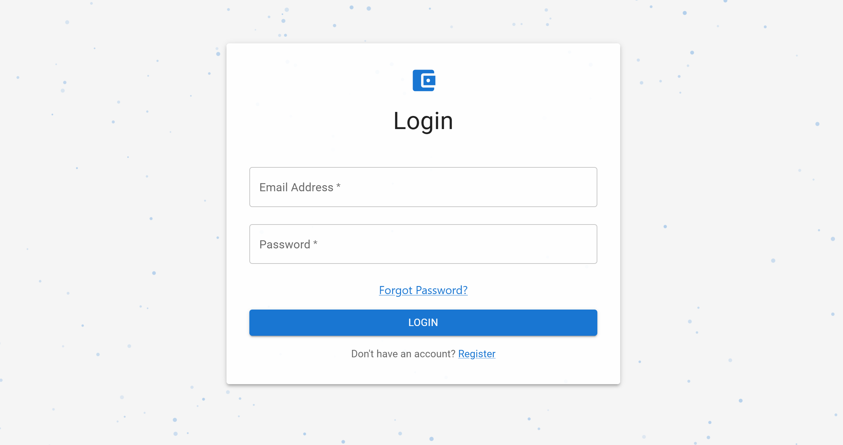
Modelling & Result

Slide 9
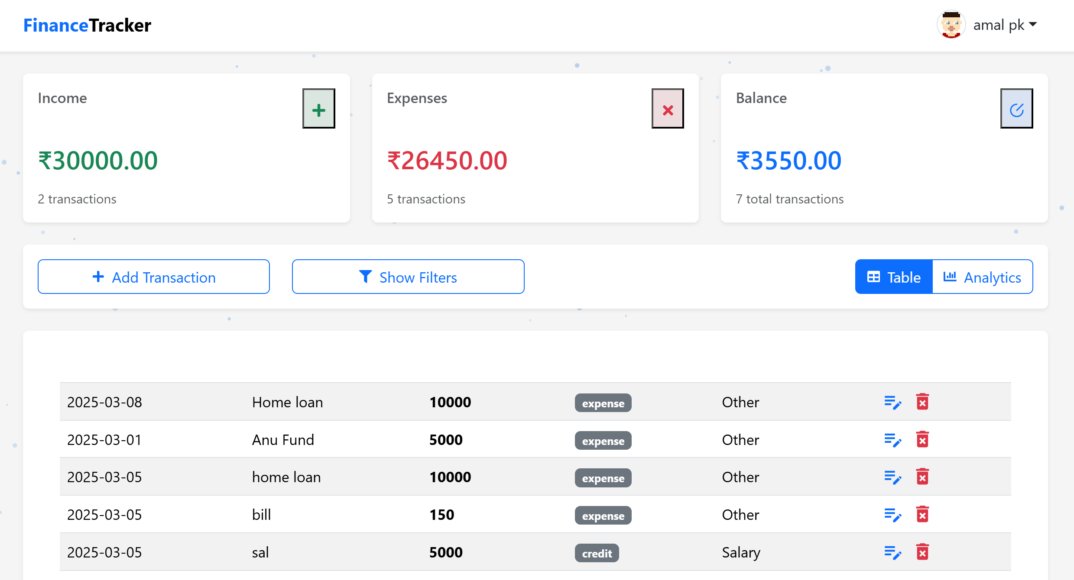
Modelling & Result
Successful CRUD operations on financial transactions.
Responsive and intuitive user interface.

Slide 10
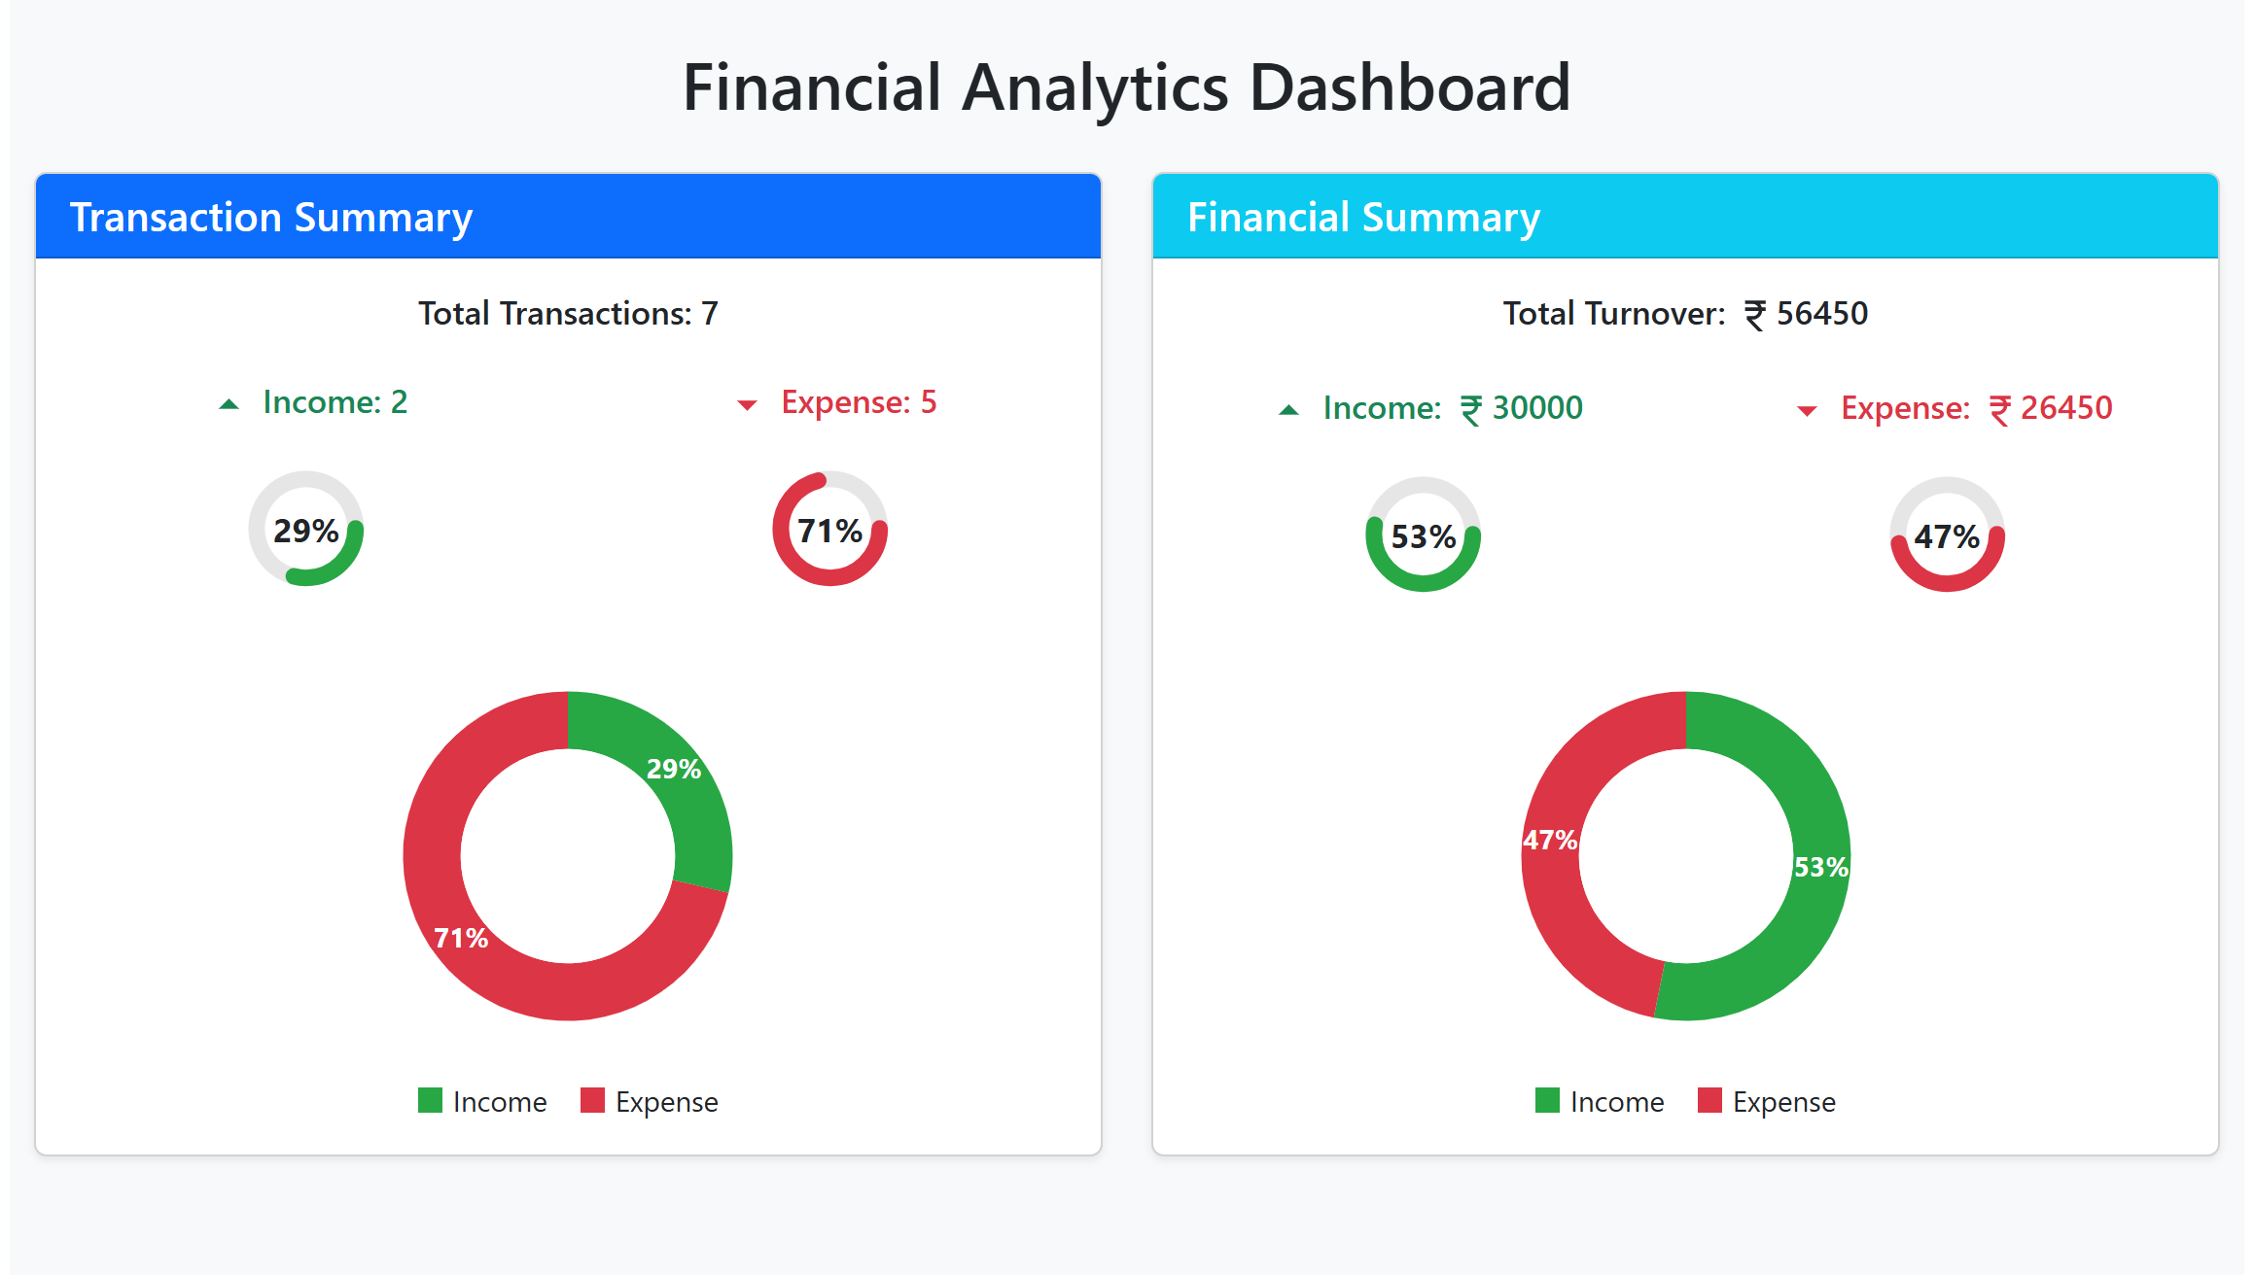
Modelling & Result

Slide 11

Conclusion
The Finance Tracker project successfully addresses the problem of personal finance management by offering an intuitive, easy-to-use, and feature-rich web application.

Slide 12


Notes:
Thank You !!

